Slide 1

GEETHANJALI COLLEGE OF ENGINEERING AND TECHNOLOGY (UGC AUTONOMOUS),
Cheeryal (V), Keesara (M), Medchal District, Hyderabad– 501 301
(Approved by AICTE, Permanently Affiliated to JNTUH, Accredited by NBA, Accredited by NAAC with
“A” Grade and ISO 9000:2015 Certified)
DEPARTMENT OF INFORMATION TECHNOLOGY
IV B.Tech II-Semester
ENHANCED CYBERCRIME UNDERGROUND ECONOMY
USING MACHINE LEARNING APPROACHES
Batch No: 13
1. 19R11A1252 – T. HARINI
2. 19R11A1228 – M. SAI CHARAN
3. 19R11A1221 – K. GOVTHAM
Under the Guidance of
Mrs . K . GNANA MAYURI
Assistant Professor

Slide 2
CONTENTS
Abstract
Introduction
Roles and Responsibilities
Existing System
Proposed System
Project Features
Reason for literature
Literature Forms
Sources of Literature
Architecture
Modules description
Algorithm
Design
Summary
Output Screenshots
Conclusion

Slide 3
ABSTRACT
Despite the rapid escalation of cyber threats, there has still been little research into the foundations of the subject or methodologies that could serve to guide Information Systems researchers and practitioners who deal with cybersecurity. In addition, little is known about Crime-as-a-Service (CaaS), a criminal business model that underpins cybercrime underground. This research gap and the practical cybercrime problems we face have motivated us to investigate the cybercrime underground economy by taking a data analytics approach from a design science perspective. To achieve this goal, we propose (1) a data analysis framework for analyzing the cybercrime underground, (2) CaaS and crimeware definitions, and (3) an associated classification model. In addition, we (4) develop an example application to demonstrate how the proposed framework and classification model could be implemented in practice. We then use this application to investigate the cybercrime underground economy by analyzing a large dataset obtained from the online hacking community. By taking a design science research approach, this study contributes to the design artifacts, foundations, and methodologies in this area. Moreover, it provides useful practical insights to practitioners by suggesting guidelines as to how governments and organizations in all industries can prepare for attacks by the cybercrime underground.

Slide 4
Introduction
As the threat posed by massive cyberattacks (e.g., ransomware and distributed denial of service attacks (DDoS)) and cybercrimes has grown, individuals, organizations, and governments have struggled to find ways to defend against them.
In 2017, ransomware known as WannaCry was responsible for nearly 45,000 attacks in almost 100 countries.
The explosive impact of cybercrime has put governments under pressure to increase their cybersecurity budgets. United States President Barack Obama proposed spending over $19 billion on cybersecurity as part of his fiscal year 2017 budget, an increase of more than 35% since 2016.
Typically, criminal groups buy and sell hacking tools and services on the cybercrime black market, wherein attackers share a range of hacking-related information. This online underground market is operated by groups of attackers, and it in turn supports the underground cybercrime economy.

Slide 5
Roles and Responsibilities
HARINI - 19R11A1252 - PROGRAMMING (PYTHON)
Organizing work and managing the project progress.
Perform necessary installations and develop the code in Python language.
GOVTHAM - 19R11A1221 – TESTING
Perform execution and testing of the project.
Document the entire process of the project.
SAI CHARAN - 19R11A1228 – DESIGNING
Creating an interactive graphical user interface.

Slide 6
EXISTING SYSTEM
Information Systems (IS) researchers and practitioners are taking an increasing interest in cybercrime, due to the critical issues arising from the rapid increase in cyber threats, few have attempted to put this new interest on a solid foundation or develop suitable methodologies. Previous studies have not analyzed the underground economy behind cybercrime in depth. Furthermore, little is known about CaaS, one of the primary business models behind the cybercrime underground. There is an overall lack of understanding, both in research and practice, of the nature of this underground and the mechanisms underlying it.

Slide 7
PROPOSED SYSTEM
The practical problems faced by cybercriminals motivate our study. We take a data analytics approach and investigate the cybercrime economy from a design science perspective. To achieve this goal, we (1) propose a data analysis framework for analyzing the cybercrime underground to guide researchers and practitioners; (2) define CaaS and crimeware to better reflect their features from both academic research and business practice perspectives; (3) use this to build a classification model for CaaS and crimeware; and (4) build an application to demonstrate how the proposed framework and classification model could be implemented in practice.

Slide 8
PROJECT FEATURES
We propose a data analysis framework for analyzing the cybercrime underground, CaaS, crimeware, and an associated classification model.
We investigate the cybercrime underground economy by analyzing a large dataset obtained from the online hacking community.
We take a data analytics approach and investigate the cybercrime economy from a design science perspective.
We first filtered the messages to select only those that carried significant risks and then divided them into categories. To determine if a given message is dangerous, our classification model checks whether it falls into which category.
Focuses on a real-time monitoring application that aims to monitor cybercrime-related discussions on social networks.
We will predict whether the data contains any cybercrime signature.

Slide 9
Reason for literature
To gain an understanding of the existing research and debates relevant to a particular topic or area of study.
It helps one to build more knowledge in the field we want to do our project in i.e. Cyber Security and Cyber crime.
Explains the essence of the underground economy that has grown around it.
Speculates on how the organization of criminal activity may evolve in cyberspace. It begins by examining organized crime in the "real world"; after defining "organized crime," it considers the advantages organization offers for group criminality in the "real world."

Slide 10
Literature Forms
FORMS | COUNT
1. ARTICLE 2. SURVEY PAPERS 3. JOURNAL 4. REPORT 5. WEBSITES 6. RESEARCH PAPERS | 3 2 2 1 3 2

Slide 11
Sources of Literature
FORM TYPE | TITLE | INSIGHTS
1. ARTICLE | Massive ransomware cyber-attack hits nearly 100 countries around the world. | This article is more than 5 years old Massive ransomware cyber-attack hits nearly 100 countries around the world
2. SURVEY PAPERS | Crimeware-as-a-service - A survey of commoditized crimeware in the underground market. | The actors, value chains, and modes of operation in underground crimeware marketplaces are examined, and three facilitating technologies are identified that are likely to significantly expand the reach of cybercriminals.
3. JOURNAL | The Novelty of ‘Cybercrime’: An Assessment in Light of Routine Activity Theory. | Recent discussions of ‘cybercrime’ focus upon the apparent novelty or otherwise of the phenomenon. Some authors claim that such crime is not qualitatively different from ‘terrestrial crime’, and can be analysed and explained using established theories of crime causation.

Slide 12
4. REPORT | A Data Analytics Approach to the Cybercrime Underground Economy | This report consists detailed summary of cyber crimes.
5. WEBSITES | Entering the world-wide-web: a guide to cyberspace. | For fifty years, people have dreamt of the concept of a universal information database--data that would not only be accessible to people around the world, but information that would link easily to other pieces of information so that only the most important data would be quickly found by a user.
6. RESEARCH PAPERS | Positioning and Presenting Design Science Research for Maximum Impact. | Design science research (DSR) has staked its rightful ground as an important and legitimate Information Systems (IS) research paradigm. We contend that DSR has yet to attain its full potential impact on the development and use of information systems due to gaps in the understanding and application of DSR concepts and methods.

Slide 13
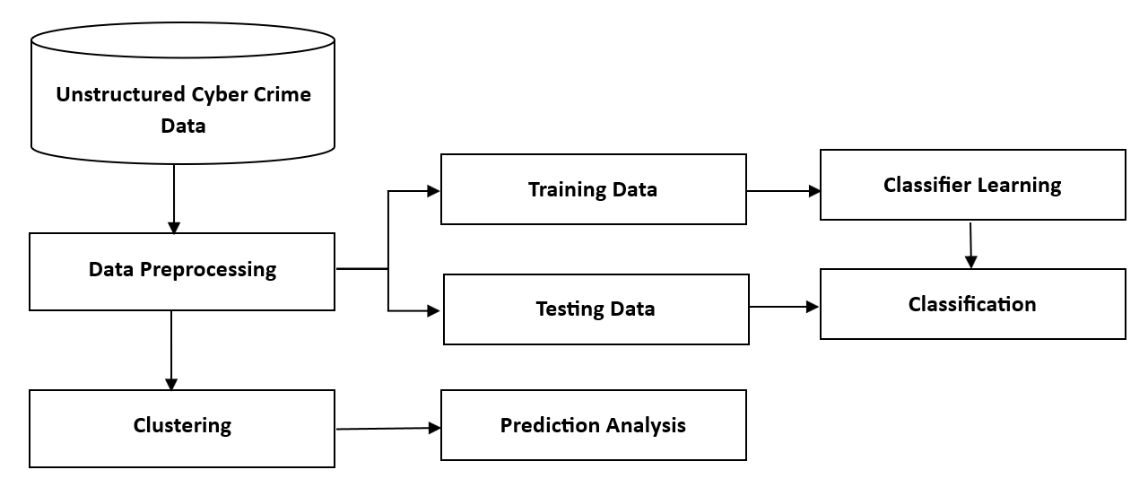
ARCHITECTURE

Slide 14
Modules description
To implement this project we have designed the following modules
Files to Upload: Users are permitted to upload files with the specified tags.
Observation of Dataset: Users are permitted to communicate with one another. The administrator could keep an eye on this. In order to defend against cybercrime and prevent the formation of a cybercrime community.
Run Naive Bayes Classification Model: using this module we will train a classification algorithm with above 80% dataset and then build a prediction model
Classification Performance Graph: using this module we will plot naïve Bayes accuracy and precision graph to know its performance accuracy
Predict Cyber Crime: using this module we will upload a test cybercrime network dataset and then the classification model will predict whether the test data contains any cybercrime signature.

Slide 15

ALGORITHM
Naive Bayes Classifier Algorithm
We employ the Naive Bayes algorithm, a probabilistic classification algorithm that addresses probabilistic reasoning under uncertainty, because it is the simplest approach for text classification. Its predictions self correct as new information is encountered, so they become more accurate with more data. The conditional probability is given by Bayes’ theorem:
Here, P(Cj) and P(Ci |d) are the prior and posterior probabilities of class Ci , while P(d) and P(d|Ci) are the prior and posterior probabilities of the predictor d. The dependent feature vector is x = (x1, x2, . . . , xn) and Bayes’ theorem gives us the following.

Slide 16
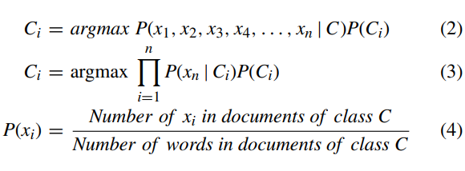
Basing the probabilistic classifier on the naïve Bayes model simplifies the conditional independence assumptions for the CaaS and crimeware classes. The sentences in a document are tokenized into words, which are classified as relating to either CaaS or crimeware. The likelihood of the document having feature xi can then be computed by dividing ‘‘the number of features xi in documents of class C’’ by ‘‘the number of words in documents of class C’’ (Equation 4).

Slide 17
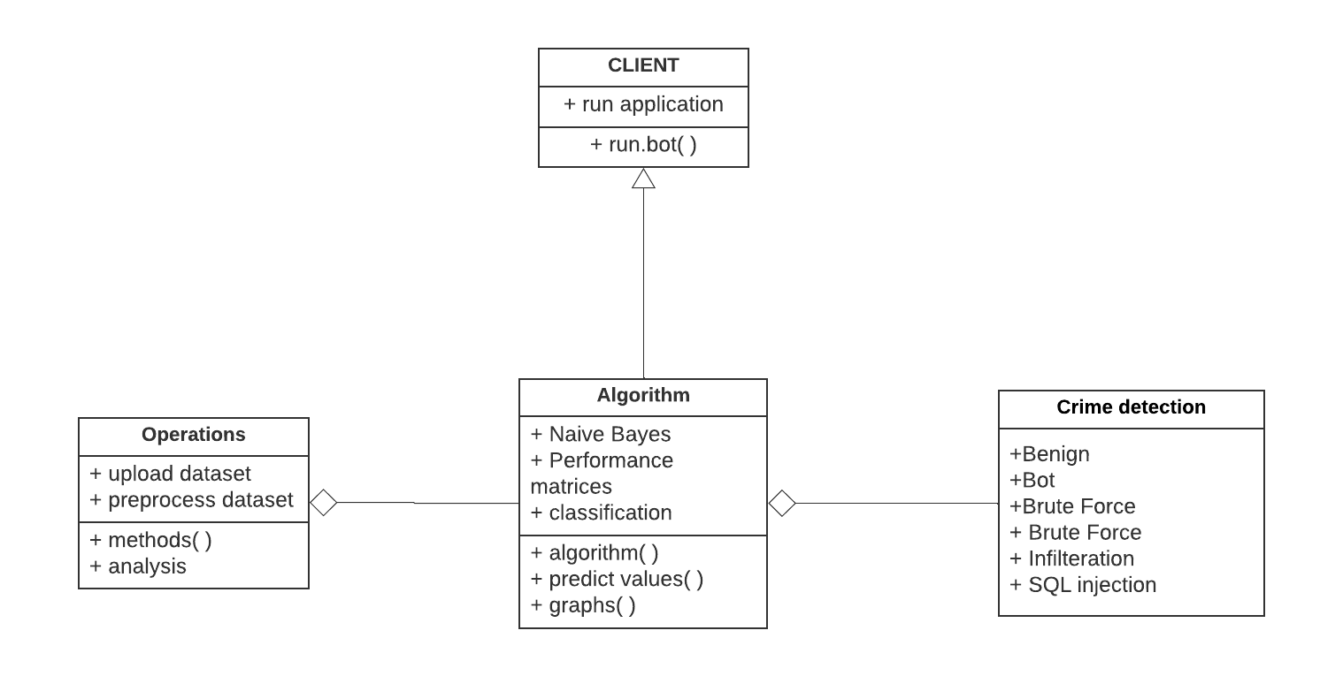
UML DIAGRAMS
CLASS DIAGRAM
The class diagram is the main building block of object-oriented modeling. It is used both for general conceptual modeling of the systematic application and for detailed modeling translating the models into programming code. Class diagrams can also be used for data modeling. The classes in a class diagram represent both the main objects, interactions in the application and the classes to be programmed.

Slide 18
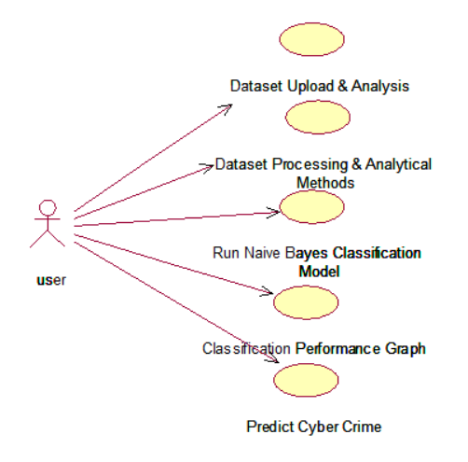
use case diagram
A use case diagram at its simplest is a representation of a user's interaction with the system and depicting the specifications of a use case. A use case diagram can portray the different types of users of a system and the various ways that they interact with the system. This type of diagram is typically used in conjunction with the textual use case and will often be accompanied by other types of diagrams as well.

Slide 19
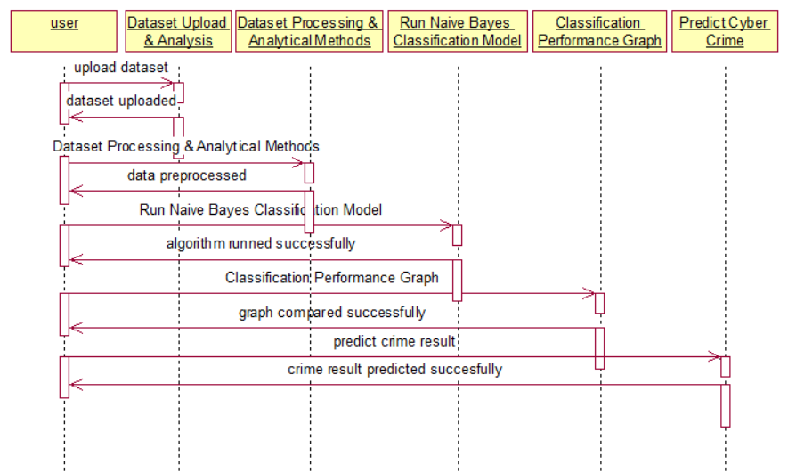
Sequence diagram
A sequence diagram is a kind of interaction diagram that shows how processes operate with one another and in what order. It is a construct of a Message Sequence Chart. A sequence diagram shows object interactions arranged in time sequence. It depicts the objects and classes involved in the scenario and the sequence of messages exchanged between the objects needed to carry out the functionality of the scenario. Sequence diagrams are typically associated with use case realizations in the Logical View of the system under development. Sequence diagrams are sometimes called event diagrams, event scenarios, and timing diagrams.

Slide 20
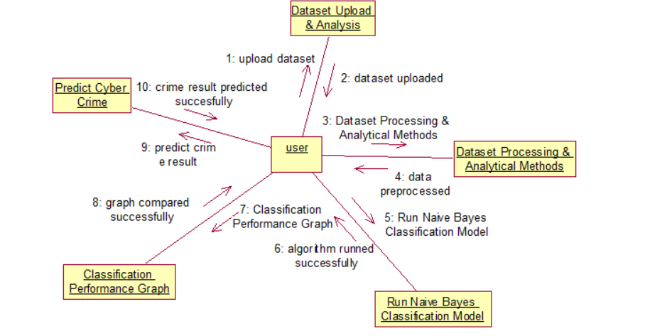
collaboration diagram
A collaboration diagram describes interactions among objects in terms of sequenced messages. Collaboration diagrams represent a combination of information taken from class, sequence, and use case diagrams describing both the static structure and dynamic behaviour of a system.

Slide 21
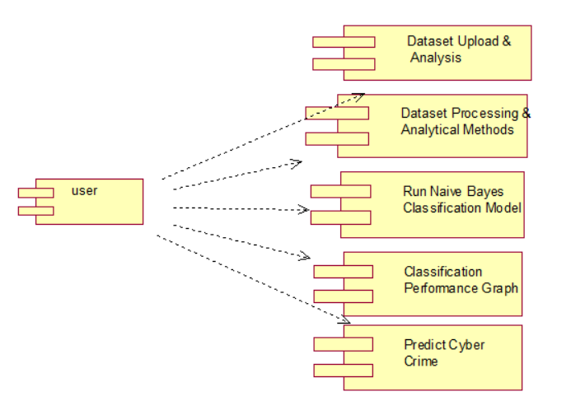
COMPONENT DIAGRAM
In the Unified Modelling Language, a component diagram depicts how components are wired together to form larger components and or software systems. They are used to illustrate the structure of arbitrarily complex systems.
Components are wired together by using an assembly connector to connect the required interface of one component with the provided interface of another component. This illustrates the service consumer - service provider relationship between the two components.

Slide 22
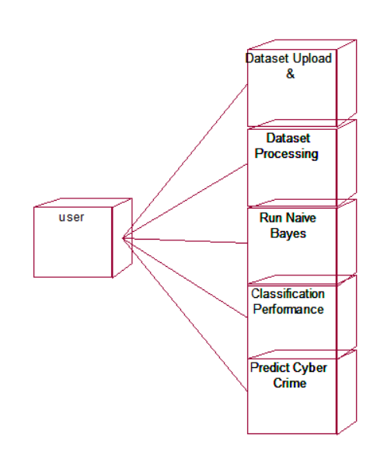
deployment diagram
A deployment diagram in the Unified Modeling Language models the physical deployment of artifacts on nodes. To describe a web site, for example, a deployment diagram would show what hardware components ("nodes") exist (e.g., a web server, an application server, and a database server), what software components ("artifacts") run on each node (e.g., web application, database), and how the different pieces are connected (e.g. JDBC, REST, RMI).

Slide 23
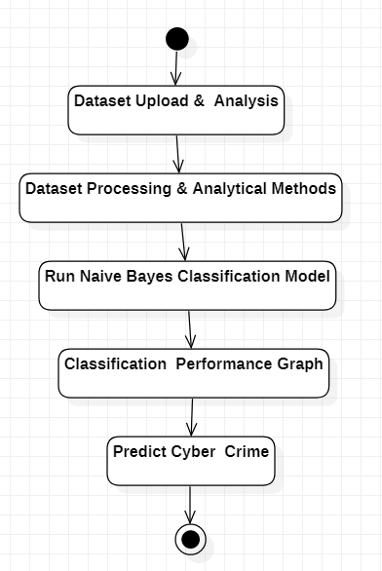
Activity diagram
Activity diagram is another important diagram in UML to describe dynamic aspects of the system. It is basically a flow chart to represent the flow from one activity to another activity. The activity can be described as an operation of the system. So the control flow is drawn from one operation to another. This flow can be sequential, branched or concurrent

Slide 24
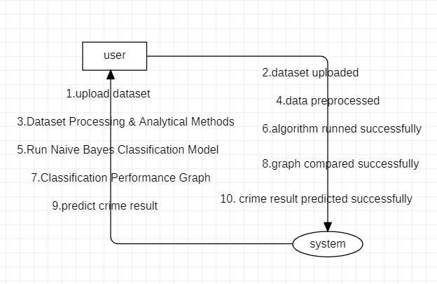
Data Flow Diagram
Data flow diagrams illustrate how data is processed by a system in terms of inputs and outputs. Data flow diagrams can be used to provide a clear representation of any business function. The technique starts with an overall picture of the business and continues by analyzing each of the functional areas of interest. This analysis can be carried out in precisely the level of detail required. The technique exploits a method called top-down expansion to conduct the analysis in a targeted way.

Slide 25
Summary
The practical problems faced by cybercriminals motivate our study. We take a data analytics approach and investigate the cybercrime economy from a design science perspective.
To achieve this goal, we (1) propose a data analysis framework for analyzing the cybercrime underground to guide researchers and practitioners; (2) define CaaS and crimeware to better reflect their features from both academic research and business practice perspectives; (3) use this to build a classification model for CaaS and crimeware; and (4) build an application to demonstrate how the proposed framework and classification model could be implemented in practice.

Slide 26
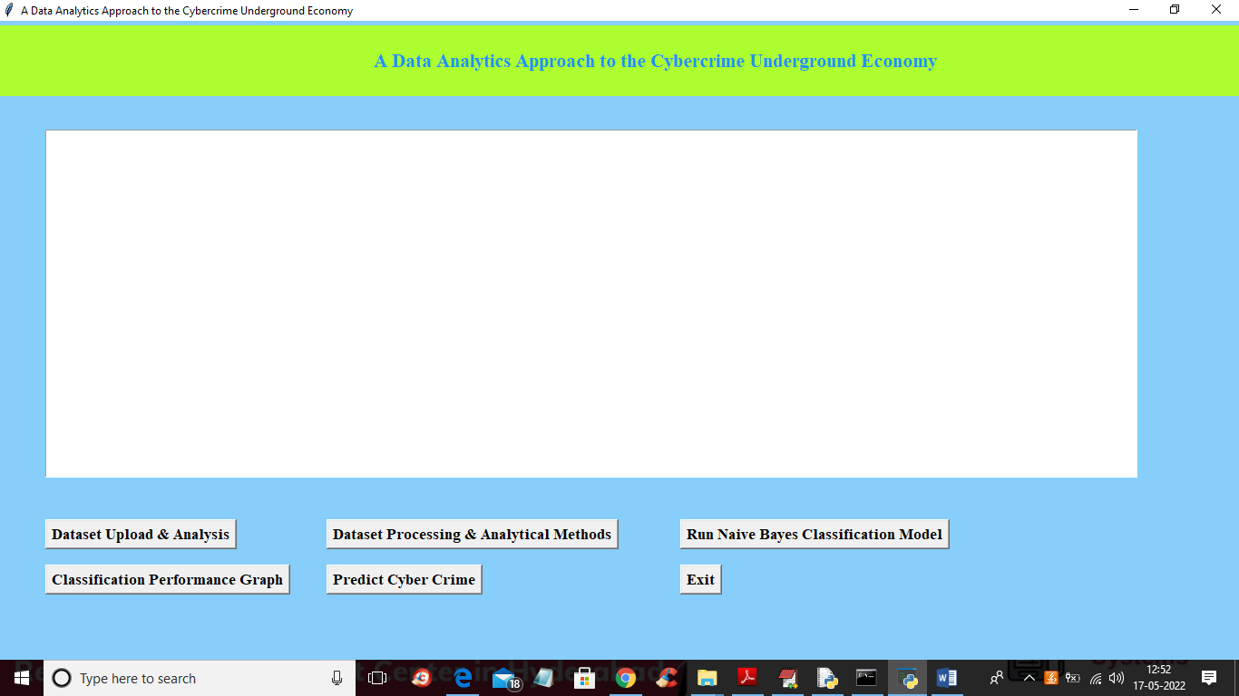
OUTPUTS
To run the project double click on the ‘run’ file to get the below output
In above screen click on ‘Dataset Upload & Analysis’ button to upload dataset and get below output.

Slide 27
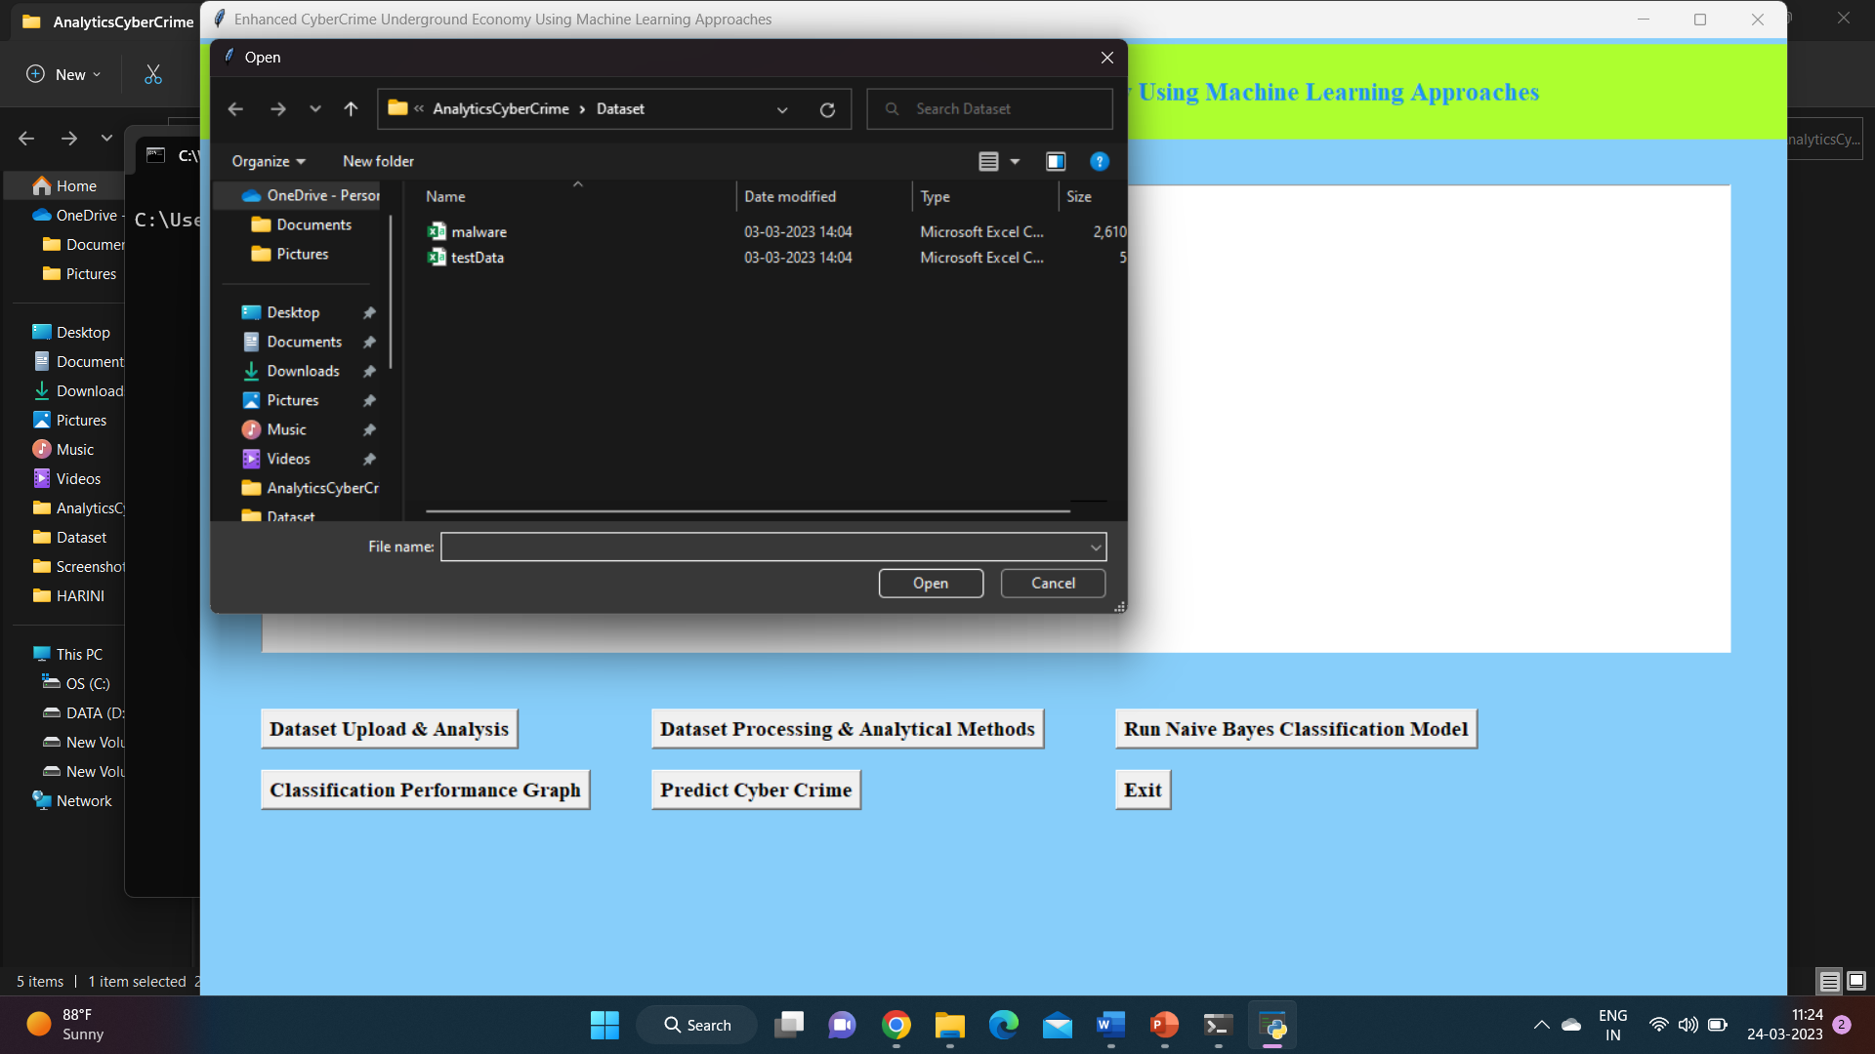
In above screen selecting and uploading ‘malware.csv’ file and then click on ‘Open’ button to load dataset and get below analysis output.

Slide 28
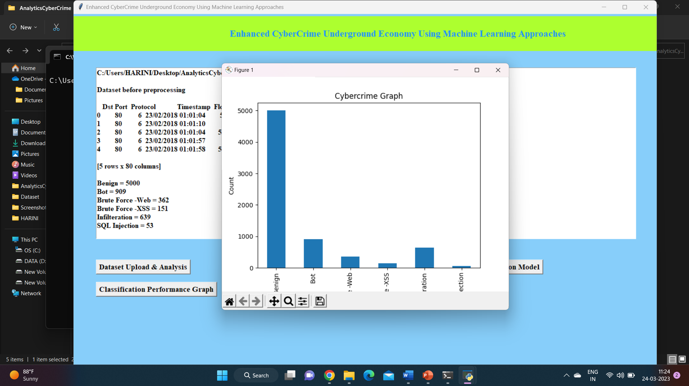
In above screen we can see dataset loaded and dataset contains some non-numeric characters and algorithm will not take such non-numeric data so we need to convert it into integer ID and in above screen we can various cybercrime and its count so by seeing this we can analyse on which cybercrime most money is using and in above graph we can see that analysis output. Now close above graph and then click on ‘Dataset Processing & Analytical Methods’ button to clean dataset and then split data into train and test.

Slide 29
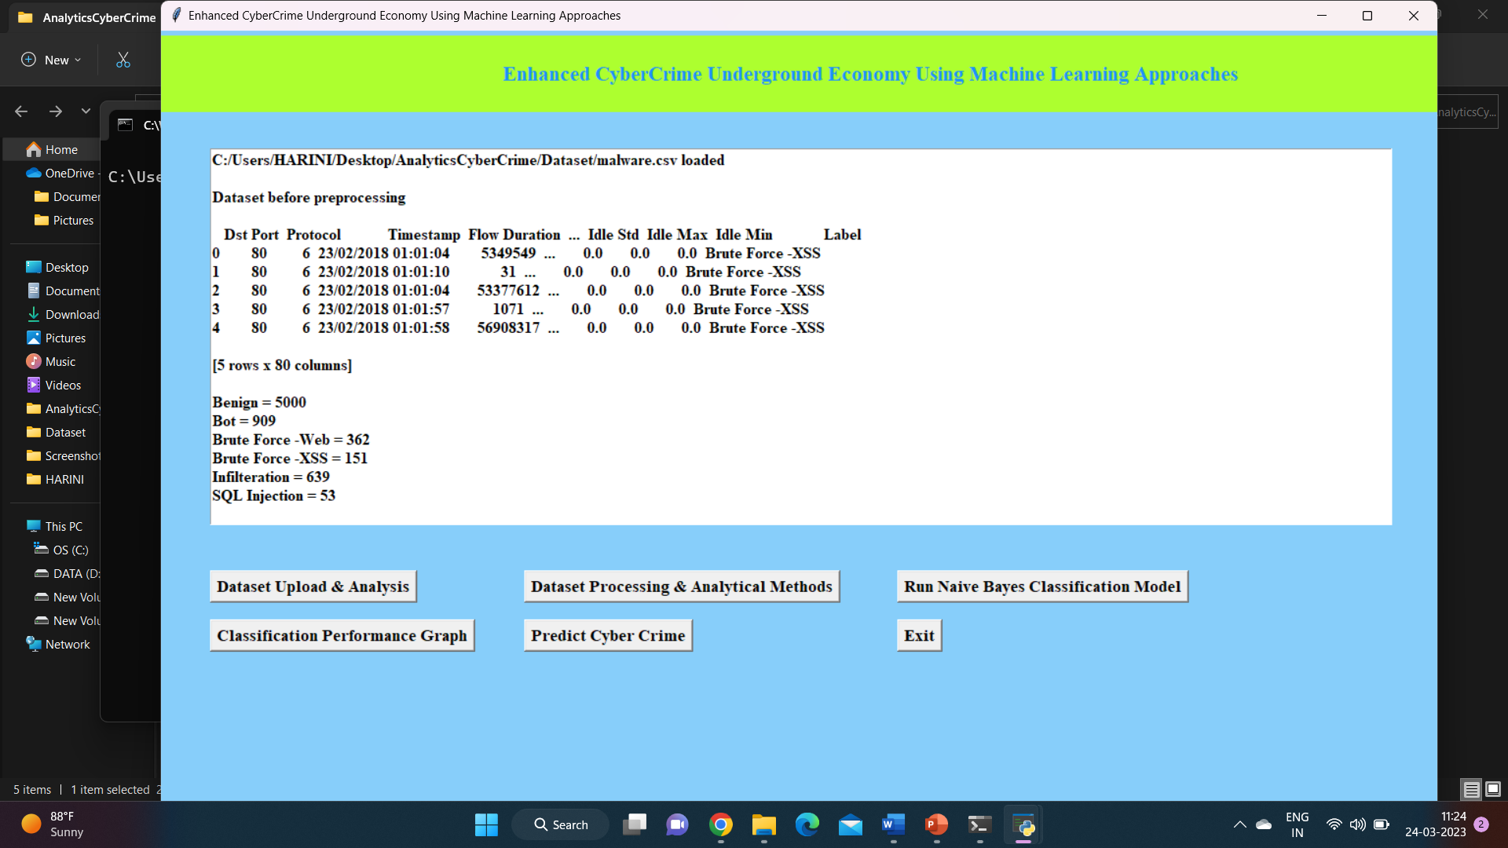

Slide 30
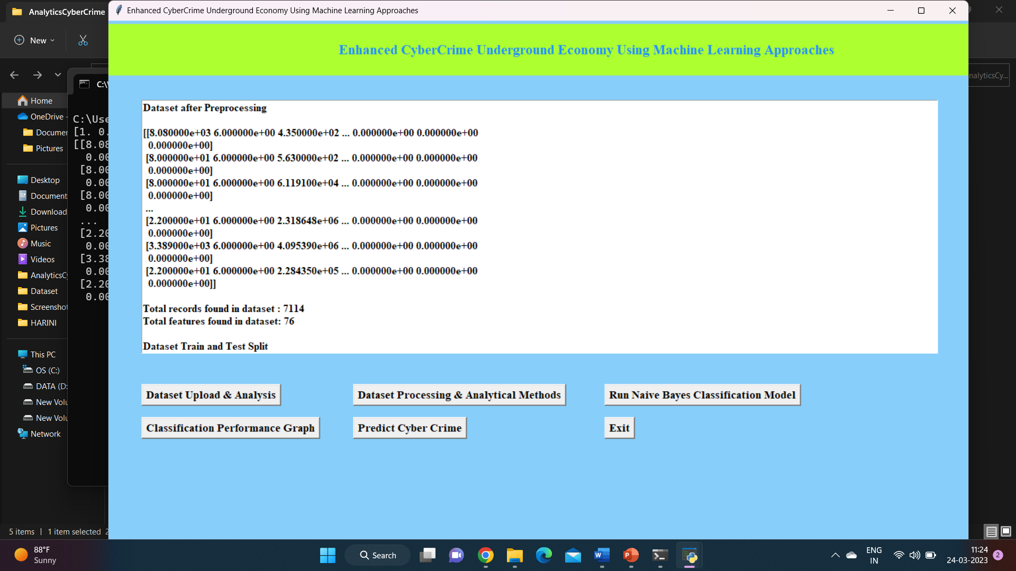
In above screen we can see all data is converted to numeric format and then we can see total dataset and then we can see 80% dataset used for training and 20 for testing and now dataset is ready and now click on ‘Run Naive Bayes Classification Model’ button to train classification model and get below output.

Slide 31
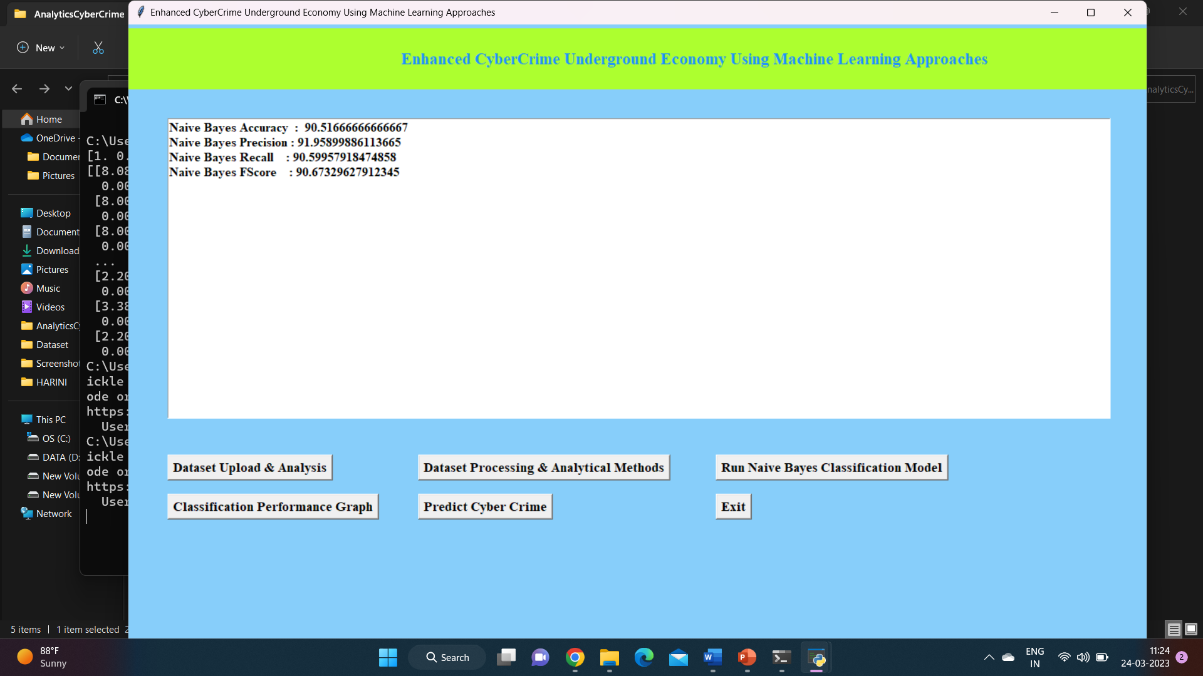
In above screen Naïve Bayes training is completed and we got its prediction accuracy as 90% and now click on ‘Classification Performance Graph’ button to get below graph.

Slide 32
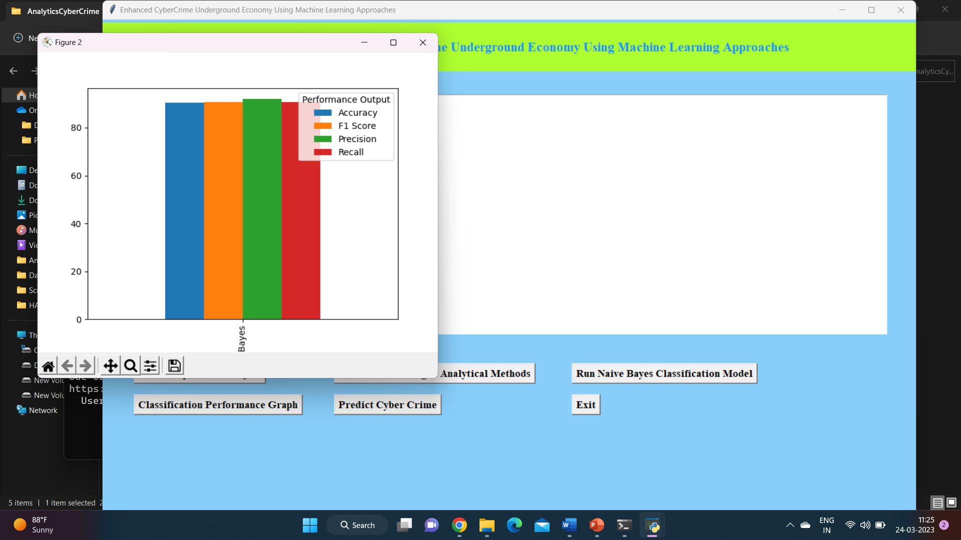
In above graph x-axis represents algorithm names and each different colour bar represents different metrics such as Accuracy, precision etc. in above graph we can see all metrics performance is above 90% and now close above graph and then click on ‘Predict Cyber Crime’ button to upload test data and get below output.

Slide 33
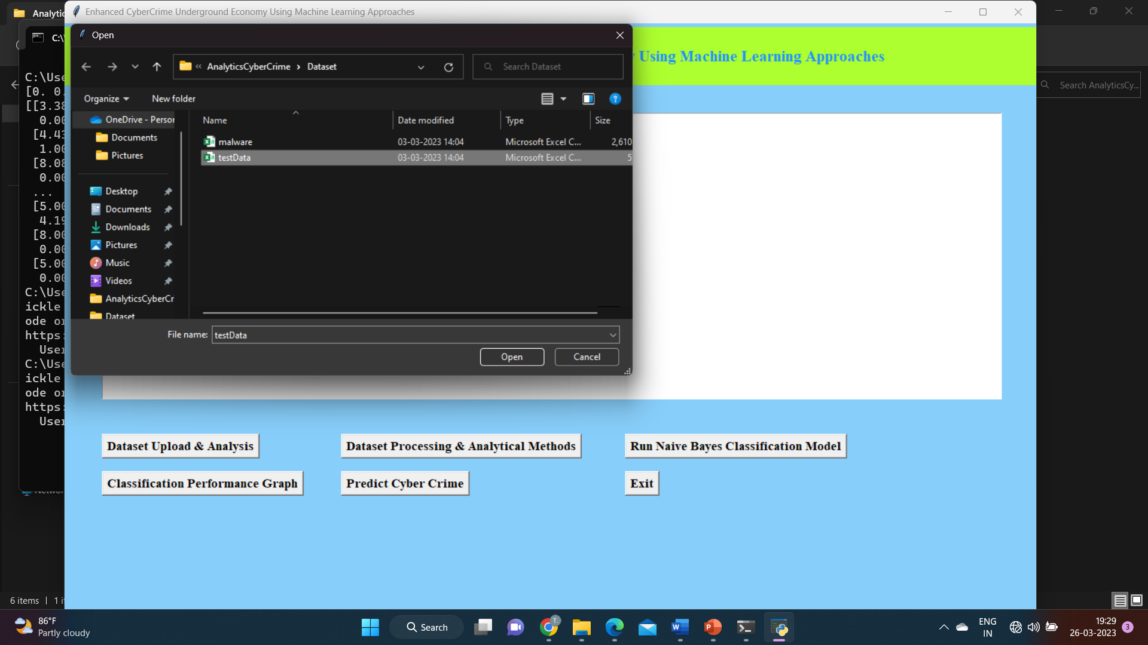
In above screen selecting and uploading ‘testData.csv’ file and then click on ‘Open’ button to get below output.

Slide 34
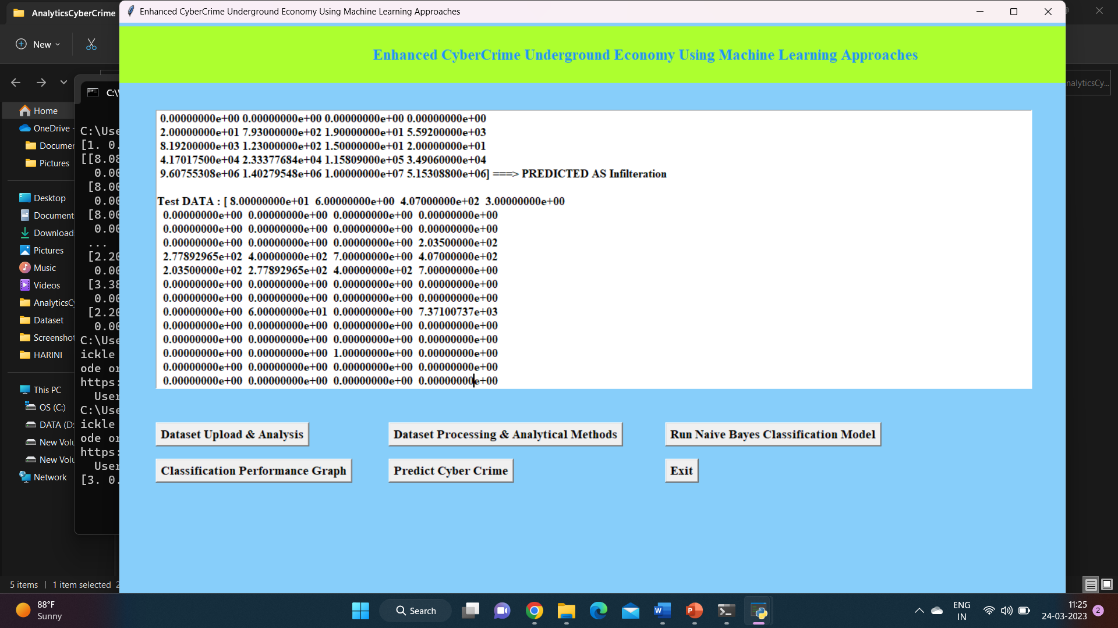
In above screen in square bracket we can see network traffic data and after arrow =➔ symbol we can see the type of cybercrime attack prediction. Scroll down above screen to view all cybercrime prediction.

Slide 35
conclusion
This study also has important implications for society. Over the last few years, the world has been facing cyberterrorism and cyberwar threats from nation-sponsored attackers. Pollitt defined cyberterrorism as “the premeditated, politically motivated attack against information, computer systems, computer programs and data which results in violence against non-combatant targets by subnational groups or clandestine agents.” Unlike most cybercrime, which is primarily motivated by monetary gain, cyberterrorists are politically motivated. As a result, governments should, for example, strengthen their ability to protect their citizens in online virtual environments by enhancing their immediate responses to threats such as cyberespionage and cyberterrorism. This issue therefore has profound implications in terms of the need for a global cyber defence to maintain a cyber-safe environment.

Slide 36
THANK YOU

